Slide 1
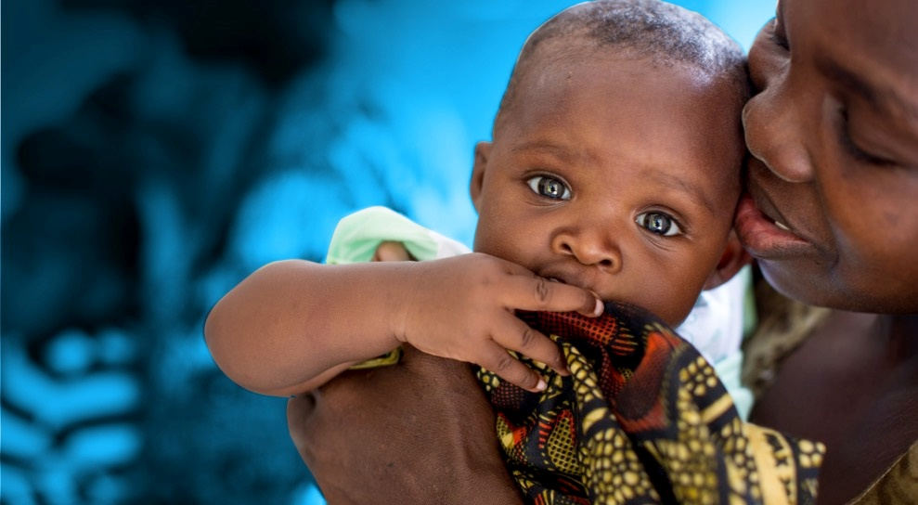
23 July 2018
Taking the Pulse
Jessica Rodrigues, UNICEF
© UNICEF/UNI197921/Schermbrucker

Slide 2
Instructions
https://web.meetoo.com/#/
Code 126635915

Slide 3
Instructions
We will ask a series of questions to gage your opinions and views on the panel discussion
3 multiple choice
Each possible answer corresponds to a color
Raise the card that corresponds to your answer
No right answer

Slide 4
Question 1:
In your opinion what is the most important data/monitoring challenge that countries needs to address?
Cohort monitoring
Disaggregated data (age and pregnancy status)
Final determination of infant status

Slide 5
Question 2:
In your opinion what is the most important barrier/challenge that Nigeria needs to address:
Loss to follow-up
Lack of services at the de-centralized level
Low ANC coverage

Slide 6
Question 3:
In your opinion what is the most important barrier/challenge that Zambia needs to address:
Loss to follow-up
Lack of services at the de-centralized level
Low early infant diagnosis

Slide 7
Question 4:
In your opinion what is the most important intervention for pregnant women that Eswatini (Swaziland) should strengthen or introduce to make progress towards EMTCT?
HIV self-testing
PrEP
Dual HIV-Syphilis testing

Slide 8
Question 5:
In your opinion what is the most important intervention for pregnant women Indonesia should strengthen or introduce to make progress towards EMTCT?
Decentralize ART for pregnant women
PrEP
Dual HIV-Syphilis testing

Slide 9
Question 6:
What is the most important contribution civil society and networks of women living with HIV can best make towards EMTCT?
Addressing Stigma
Keeping mothers and infants in care (retention in care)
Designing programmes

Slide 10
THANK YOU
© UNICEF/UN070230/Chisiza

